Slide 1
Predict Fake News
By : Yashasvi Shukla
EnrolLMent No: 40AIML692-21/1

Slide 2
What , why and it’s implications
A short definition of fake news is a news article or content created with false information to mislead readers and spread false claims. Fake news is created by different people for various reasons including financial and political gain.
Is social media to be blamed for the spread of fake news?
Users in social media trust, like and share articles shared by their friend
Humans can’t fact check each and every article or blog read on internet
Implications
https://www.snopes.com/fact-check/morgan-freeman-death-hoax/
Morgan freeman was declared dead in 2010 by CNN news channel according to some tweets. Later
CNN reported that it’ not true
Implications
https://www.snopes.com/fact-check/morgan-freeman-death-hoax/

Slide 3
Challenges
Challenging problem to collect the available datasets.
Authenticated fact checked data sources
Datasets published for research purposes
Kaggle, GitHub – how much can we trust?
Data cleaning and preparation for model building.
Compute resources

Slide 4
Data Cleaning & featurization
Cleaning: As part of data cleaning I have removed links, stopwords, html tags, performed lemmatization etc.
Numerical Feature Engineering:
Computational/Statistical Features
=> Number of words, sentences and article length
=> Question mark and Exclamation marks
=> Cognitive Perception
Morphological Analysis - POS tagging
Lexical Diversity – Number of unique words
Sentiment Analysis

Slide 5
Performance metrics
Accuracy - ratio of correct prediction to the total number of predictions made
Precision - It is defined as the ratio of relevant instances made out of all retrieved instances.
Recall - ratio of correctly predicted positive class out of total actual positive class.
F1-Score - harmonic mean of precision and recall

Slide 6
APPROACHES
Binary classification problem F : E => { 0, 1} such that,
F(a) = {
0, if fake news,
1, otherwise }
Machine Learning models has ben trained and tested on Numerical features, Count Vectors and TF-IDF vectors.
Deep Learning models (LSTMs and Bi-directional LSTMs ) has been trained and tested on word2vec vectors

Slide 7
Machine Learning Performance Result

Slide 8
Deep Learning Performance Result

Slide 9
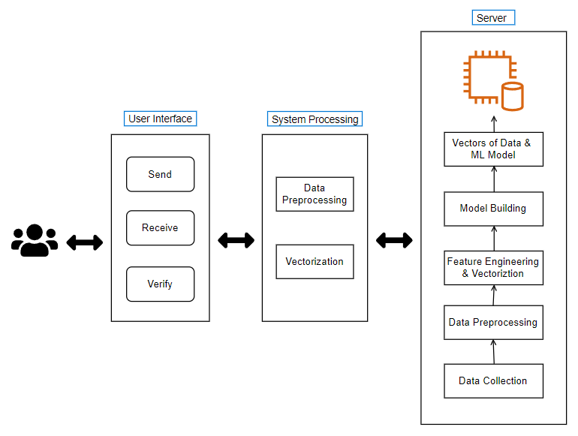
System ARCHITECTURE

Slide 10
SUMMARY
Model was trained using Scikit learn and Tensorflow.
Random Forest seems to be performing better than any other algorithms
LSTMs giving highest accuracy on test data created during train-test split.
Logistic Regression tends to be over performing any other algorithm with Count Vectorizer.
Articles with less number of words holds major part of misclassification.
LR model trained on CV’s has been deployed on server for classification. click here
System configuration:
Model – Acer Nitro 5
CPU – Intel i5 – 10300H
GPU – NVIDIA GeForce GTX 1650Ti

Slide 11
Questions?
Reach me on twitter: @shuklayashasvi
Linkedin: https://www.linkedin.com/in/yashasvi--shukla/
Github: https://github.com/yashasvi-shukl/FakeNews.git

